Slide 1
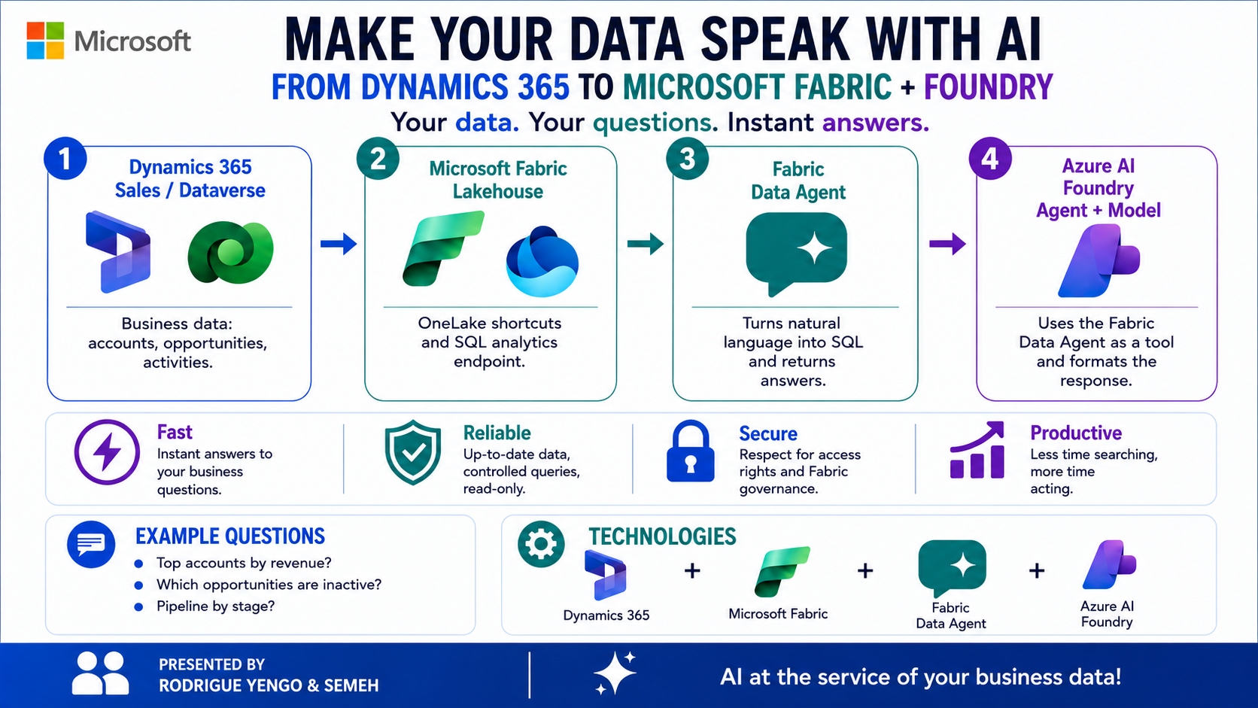


||
Rodrigue & Semeh
Notes:
Show the top 5 opportunities with the highest Budget Amount. Show total estimated value of open opportunities by stage. Show the opportunity win rate by sales representative for the current quarter. Semeh
Hi everyone, I'm Semeh...
Rodrigue
...and I'm Rodrigue.
Today, we're going to show you how we taught Dynamics 365 to answer questions.
Rodrigue
Every company stores valuable business data inside Dynamics 365.
Customers, accounts, opportunities, activities...
The information is there.
But getting answers often means opening multiple screens, searching through dashboards, or asking someone to build a report.
So we asked ourselves:
What if anyone could simply ask a question in natural language and immediately get an answer from their live CRM data?
That's exactly what we built.
Semeh
The architecture is surprisingly simple.
Semeh
Our first question is one every sales manager asks.
"What are my top five accounts with the most open opportunities but no activity during the last 30 days?"
Show the top 5 opportunities with the highest Budget Amount.
Rodrigue
Notice what happened.
No SQL.
No report.
No dashboard navigation.
We simply asked the question.
Show the top 5 opportunities with the highest Budget Amount.
Show total estimated value of open opportunities by stage.
Show the opportunity win rate by sales representative for the current quarter.
Semeh
Let's try another one.
"Which sales representative has the highest potential revenue in the pipeline this quarter?"
Rodrigue
The agent analyzes the opportunities, aggregates the revenue, and immediately identifies the top performer.
Again, no technical knowledge required.
Just a question.
Semeh
One last example.
"Show the total value of open opportunities by sales stage."
Rodrigue
Now we have an instant view of the entire sales pipeline.
Not by building a report...
Simply by having a conversation with our CRM.
Rodrigue
What we've shown today isn't just another chatbot.
It's a new way to interact with enterprise data.
Semeh
Instead of searching for information...
you simply ask for it.
Rodrigue
Dynamics 365.
Microsoft Fabric.
Azure AI Foundry.
Three Microsoft technologies working together to transform business data into instant business answers.
Thank you.

Slide 2
|
Rodrigue & Semeh
Notes:
Step 1: The Business Problem
Hi everyone.
Today, I'd like to show you how we taught Dynamics 365 to answer questions.
Every company stores valuable business data inside Dynamics 365.
Customers, accounts, opportunities, activities...
The information is already there.
But getting answers is often much harder.
You open multiple screens.
You search through dashboards.
Or you ask someone to build a report.
So we asked ourselves a simple question:
What if anyone could ask a question in natural language and instantly get an answer from their live CRM data?
That's exactly what we built.
Step 2: The Architecture
The solution relies on three Microsoft technologies.
First, Dynamics 365 Sales.
This is where the operational data lives.
Using Link to Microsoft Fabric, the data is synchronized automatically into OneLake.
No custom ETL.
No pipelines to maintain.
Second, Microsoft Fabric.
Here we create a Data Agent.
The agent understands the business model, translates natural language into SQL, executes the query, and returns the answer securely.
Finally, Azure AI Foundry.
The Foundry Agent provides the conversational experience.
So the flow is simple:
Dynamics provides the data.
Fabric understands it.
Foundry makes it conversational.
Now let's see it in action.
Step 3: Demo 1 - Sales Performance
Our first question focuses on sales performance.
"Show the opportunity win rate by sales representative for the current quarter."
Within seconds, the agent calculates the win rate for every sales representative and ranks their performance.
No SQL.
No report.
Just a business question.
Step 4: Demo 2 - Highest Value Opportunities
Let's ask another question.
"Show the top 5 opportunities with the highest Budget Amount."
Immediately, the agent identifies the five biggest opportunities currently in the pipeline.
Sales managers instantly know which deals deserve the most attention.
Step 5: Demo 3 - Pipeline Overview
Finally, let's get a complete view of the sales pipeline.
"Show total estimated value of open opportunities by stage."
In just a few seconds, we get a complete breakdown of the pipeline across every sales stage.
Again...
No dashboard.
No report design.
Just a conversation.
Step 6: Key Takeaway
What we've shown today isn't just another chatbot.
It's a new way to interact with enterprise data.
Instead of searching for information...
you simply ask for it.
Dynamics 365.
Microsoft Fabric.
Azure AI Foundry.
Three Microsoft technologies working together to transform business data into instant business answers.
Thank you.

